Slide 1





Introduction to R (+)
...because (you) R not alone
Muhammad Aswan Syahputra
@aswansyahputra

Slide 2
Know your neighbour!
...because (you) R not alone

Slide 3

Founded by Ross Ihaka & Robert Gentleman
High level language
Interactive & Programming
A swiss army knife for statistical tests and models, out-of-the box!

Slide 4
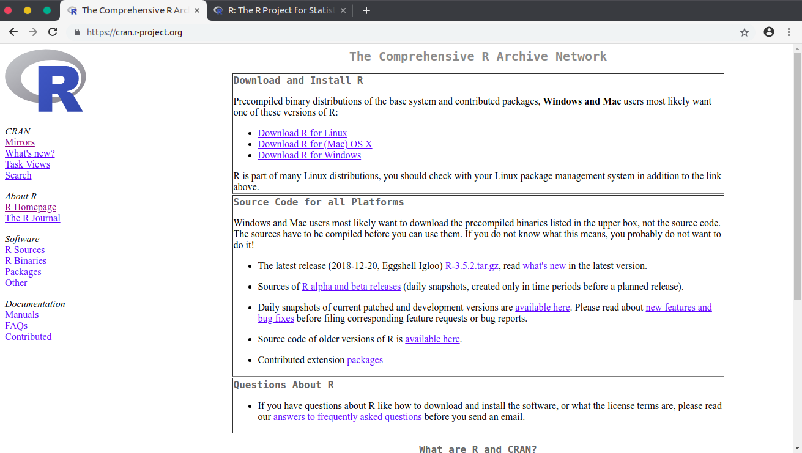
Download: cran.r-project.org

Slide 5
“The closer you are to statistics, research, and data science, the more you might prefer R”

Slide 6



R (+)

Slide 7
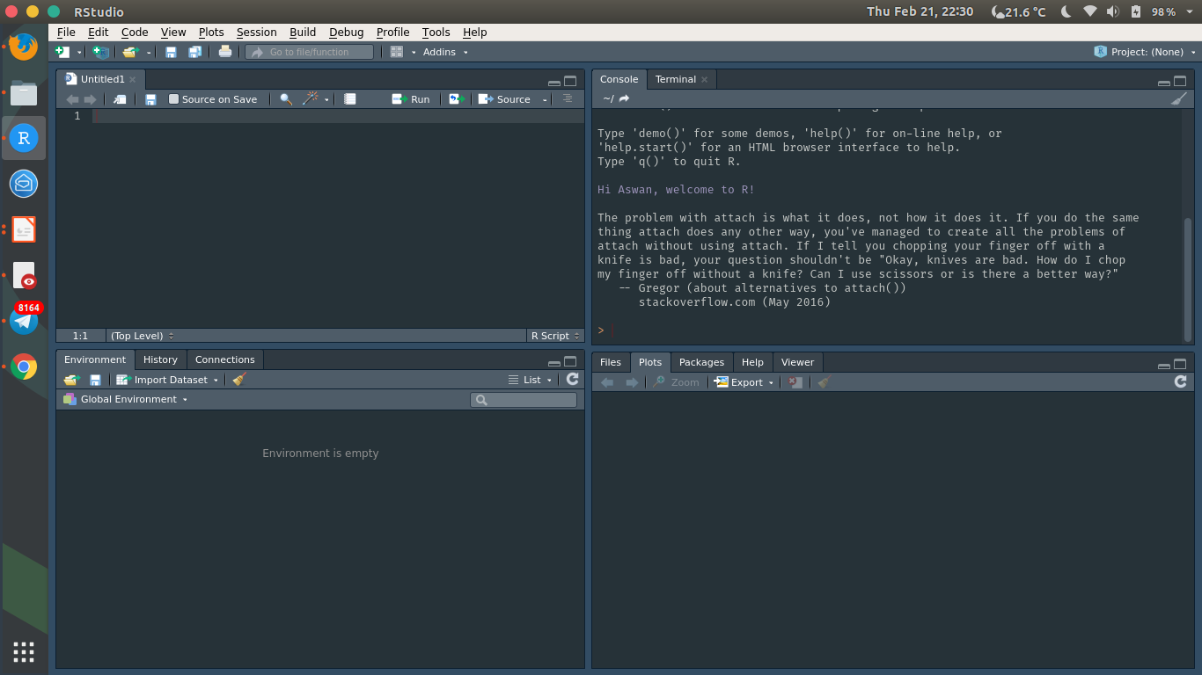
Main features:
Console
Syntax-highlighting editor
Tools for plotting, history, debugging and workspace management

Slide 8
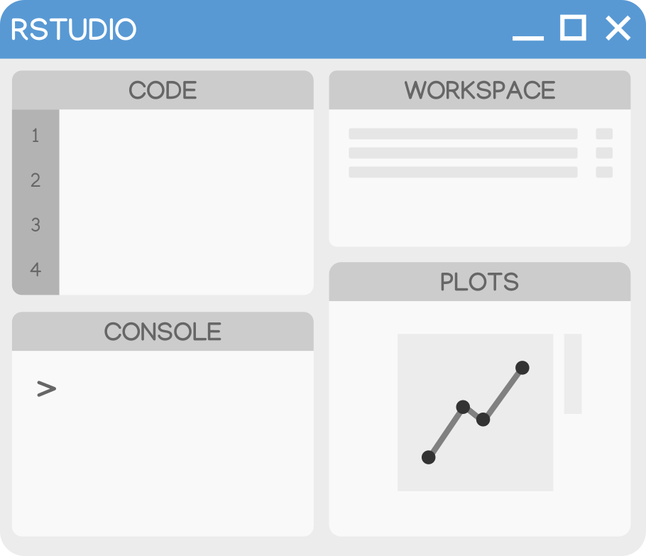
Lets try it out!
play with and set RStudio

Slide 9

- use Projects, not setwd(...)
- use script, try to avoid console
- Ctrl+Shift+F10 and Ctrl+Alt+B, not rm(list=ls())
- Tab is your friend!
- learn the handy shortcuts
- do not save and load .Rdata
- set up the .Rprofile
- use git!
Reading: happygitwithr.com
Download: git-scm.com/

Slide 10
With great codes,
comes great bugs!
- (not) Uncle Ben
store and share: github.com

Slide 11
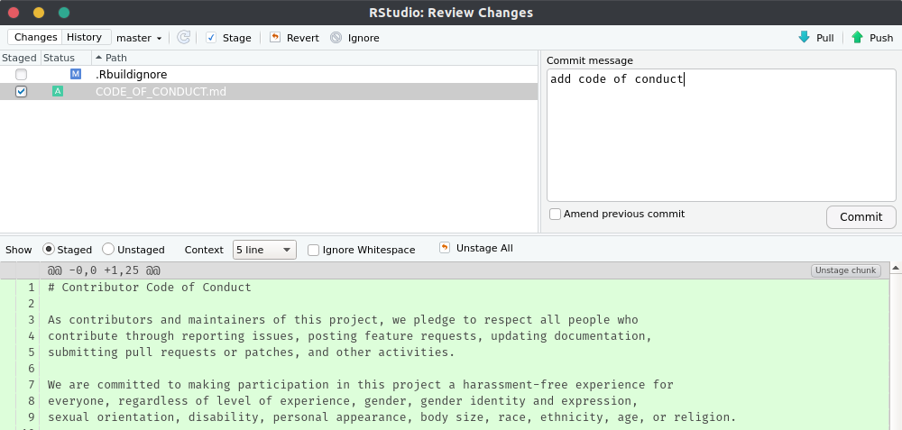
Keep track of your code with Version Control System
It is available in RStudio!

Slide 12
Tidyverse?

Slide 13

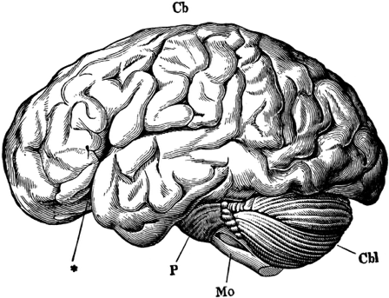

Human thought
Machine Language
Source: https://github.com/rstudio-education/arm-workshop-rsc2019

Slide 14
Human thought
Machine Language
Source: https://github.com/rstudio-education/arm-workshop-rsc2019

Slide 15
The tidyverse is an opinionated collection of R packages designed for data science.
Human thought
Machine Language
Source: https://github.com/rstudio-education/arm-workshop-rsc2019

Slide 16
Data science activity
Visualise
Import
Tidy
Transform
Communicate
Model
Understand
Program

Slide 17
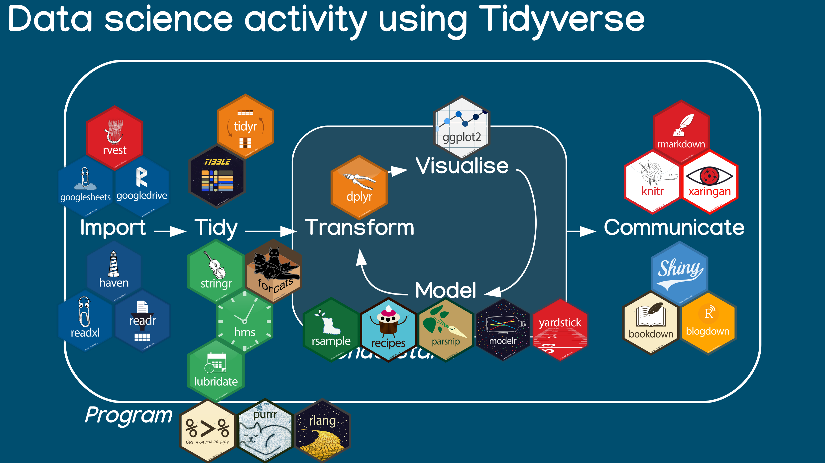

Slide 18
any_function(arg1, arg2, arg3, ...)
change_the_world(...)
calculate_value(...)
assign. <- , =, ->
- arguments are the contexts of a function
- arguments are matched by name, or
- arguments are matched by position, be careful!

Slide 19
How to chain?
...because (functions) R not alone

Slide 20


Slide 21
1. diputar
2. dijilat
3. dicelupin
4. dimakan :D

Slide 22
1. putar(apa)
2. jilat(apa, berapa_kali)
3. celup(apa, ke)
4. makan(apa, output)

Slide 23
a
> oreo_putar ← putar(apa = “oreo”)
> oreo_jilat ← jilat(apa = oreo_putar,
berapa_kali = 2)
> oreo_celup ← celup(apa = oreo_jilat,
ke = “susu”)
> makan(apa = oreo_celup,
output = “kenyang.perut”)

Slide 24
a
> oreo_putar ← putar(apa = “oreo”)
> oreo_jilat ← jilat(apa = oreo_putar,
berapa_kali = 2)
> oreo_celup ← celup(apa = oreo_jilat,
ke = “susu”)
> makan(apa = oreo_celup,
output = “kenyang.perut”)

Slide 25
b
> makan(
celup(
jilat(
putar(apa = “oreo”),
berapa_kali = 2
),
ke = “susu”
),
output = “kenyang.perut”
)

Slide 26
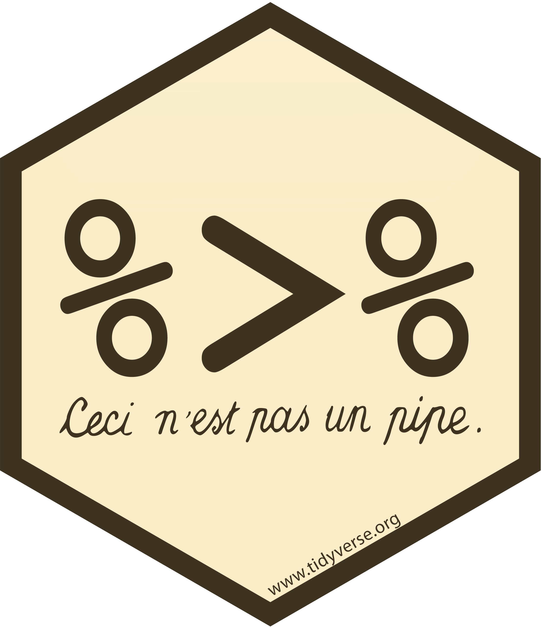
function(arg1, arg2, arg3,...)
pipe
arg1 %>%
function(arg2, arg3,...)
function(arg1, arg2, arg3,...)
arg2 %>%
function(arg1, arg2=.,arg3,...)

Slide 27
c
> putar(apa = “oreo”) %>%
jilat(berapa_kali = 2) %>%
celup(ke = “susu”) %>%
makan(output = “kenyang.perut”)

Slide 28
How to plot?
...because (plotting systems) R not alone

Slide 29
base
lattice
ggplot

Slide 30

ggplot(data) +
geom_X(mapping=aes(…)) +
...
ggplot2
ggplot(data, mapping=aes(...)) +
geom_X() +
...
data %>%
ggplot(mapping=aes(...)) +
geom_X() +
...

Slide 31
Let’s hand on!
...and have a lot of stress fun!

Slide 32
Next? Have fun!

Slide 33
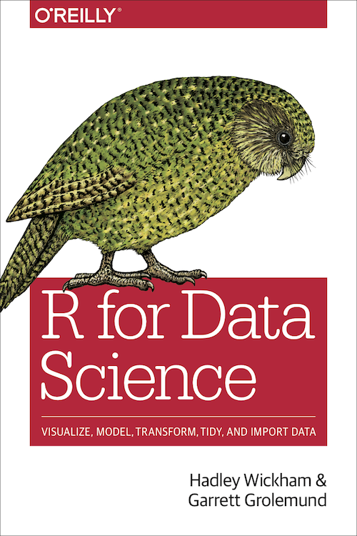
Need help?
R for Data Science
(r4ds.had.co.nz)
Introduction to Statistical Learning
(www-bcf.usc.edu/~gareth/ISL/)
Online books
(bookdown.org)
Online course
(2 m.o access at DataCamp >> my.visualstudio.com)
install.packages(“swirl”)

Slide 34
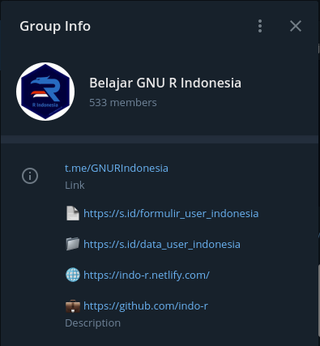
R Indonesia
Telegram:
@GNURIndonesia (t.me/GNURIndonesia)
Web:
www.r-indonesia.id
GitHub:
www.github.com/indo-r

Slide 35
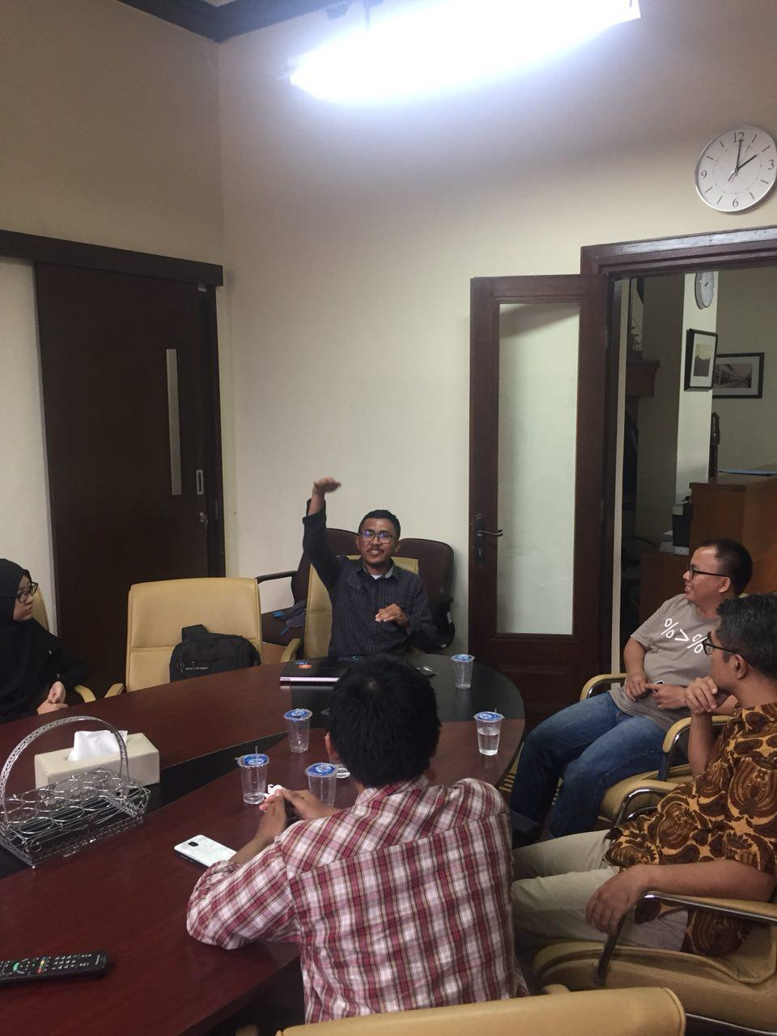
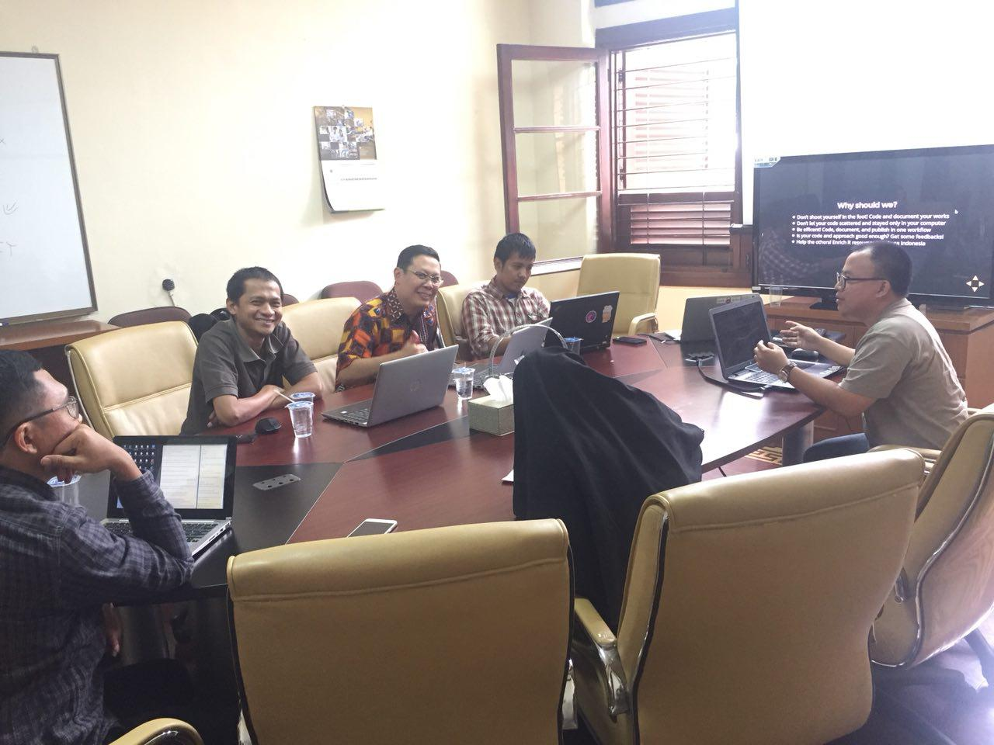
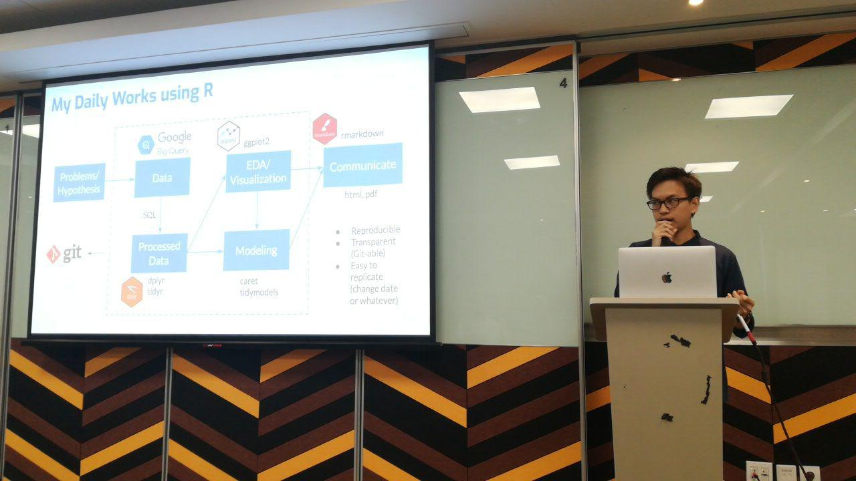
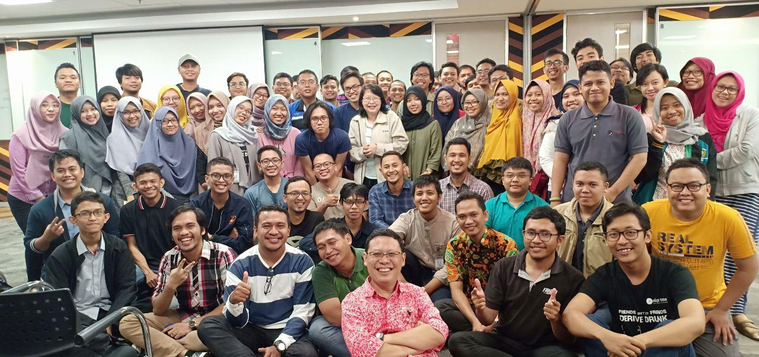
R Indonesia

Slide 36
Thanks!
aswansyahputra@sensolution.id
www.aswansyahputra.com

